Slide 1

CSE 3200 System Development Project
AALAP – A CHATTING APPLICATION
Supervised By
Kazi Saeed Alam Lecturer Dept. of Computer Science and Engineering Khulna University of Engineering & Technology
Team Members
Proloy Karmakar
1907051
Md Sakib Hasan
1907052

Slide 2
Outline
Introduction
Objectives
Methodology
Implementation
Tools/Platform Used
Future Scope
Conclusion
Reference

Slide 3

Introduction
Thе demand for effective and user-friendly communication tools is constantly rising in the modern digital environment. .
In answer to this nееd, "Aalap" appears, aiming to offer a smooth and user friendly chat program for users to communicatе and еngagе.

Slide 4

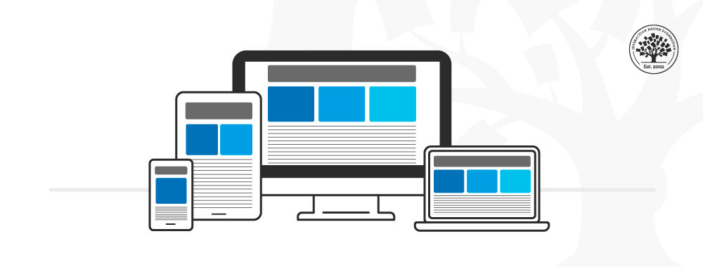
Objectives
Real Time Messaging
User Friendly Interface
Responsive Design
Scalability

Slide 5
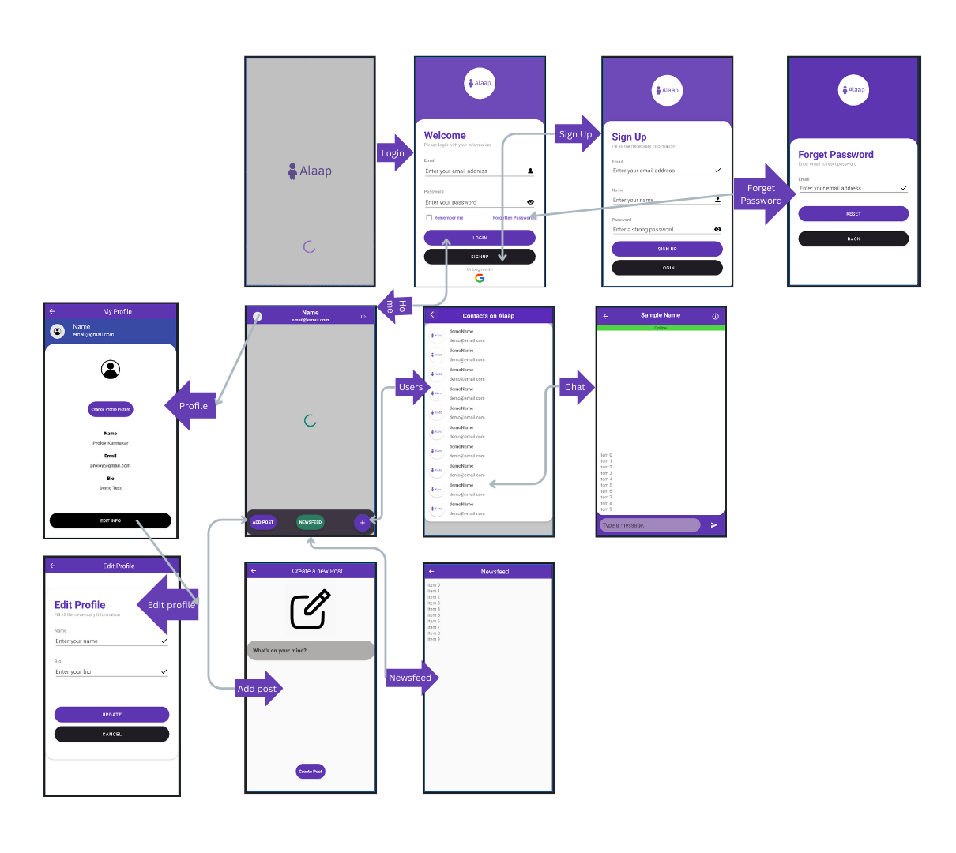
Methodology
Workflow Diagram
Fig 1: Workflow Diagram

Slide 6
App Features
Sign In options ( Google and Email)
Reset Password option
Real Time Chat
Push notification
Active Status
My profile
Edit My Profile
Share Post
News-Feed

Slide 7
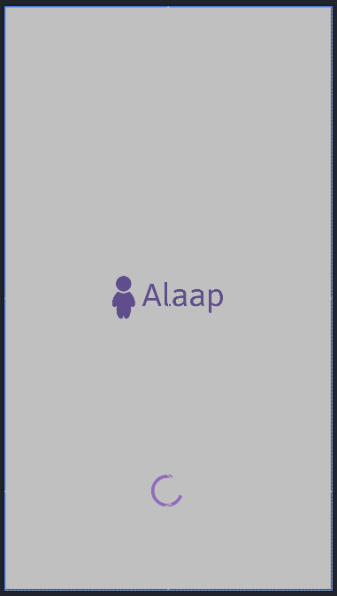
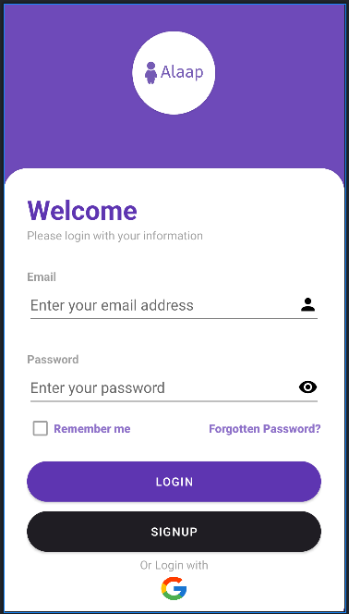
Implementation
Fig 2: Splash Screen
Fig 3: Log in Page

Slide 8
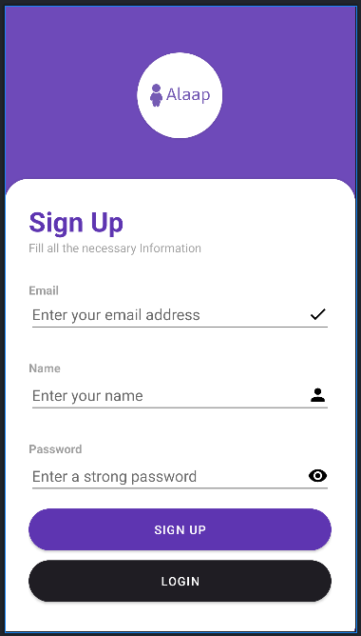
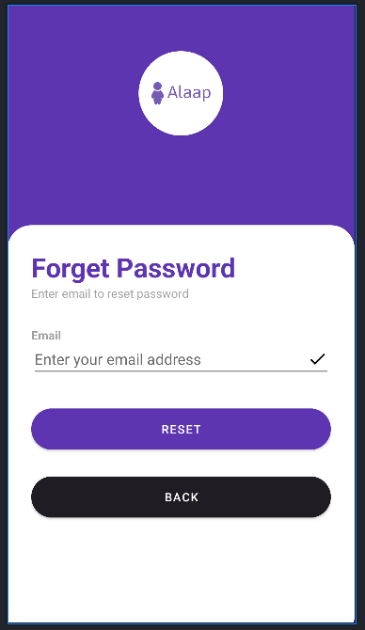
Implementation (cont.)
Fig 4: Sign Up Page
Fig 5: Forget Password

Slide 9
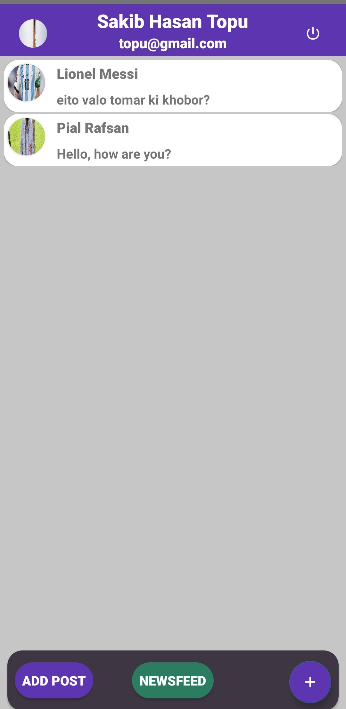
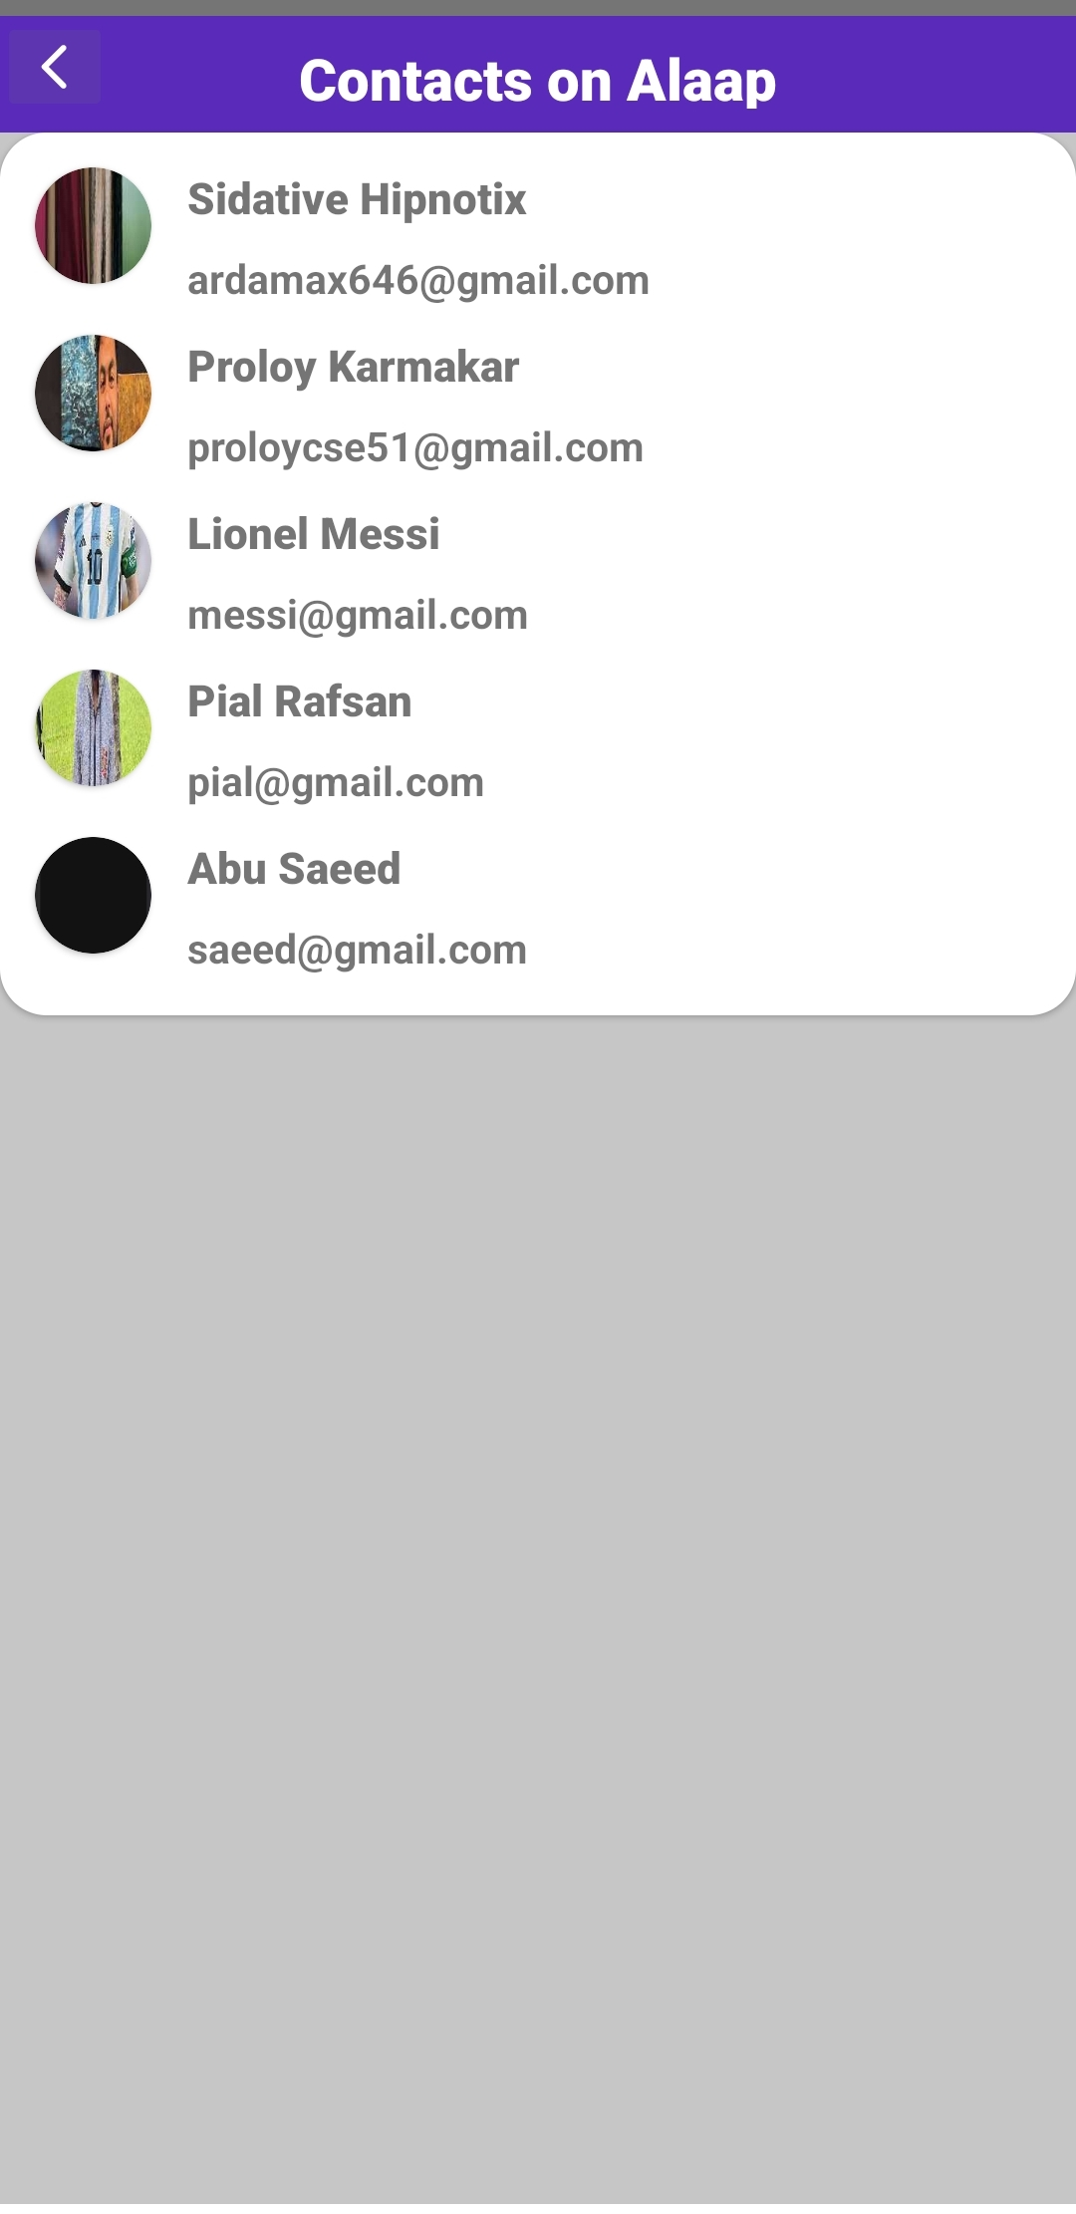
Implementation (cont.)
Fig 6 : Home Page
Fig 7: User List

Slide 10
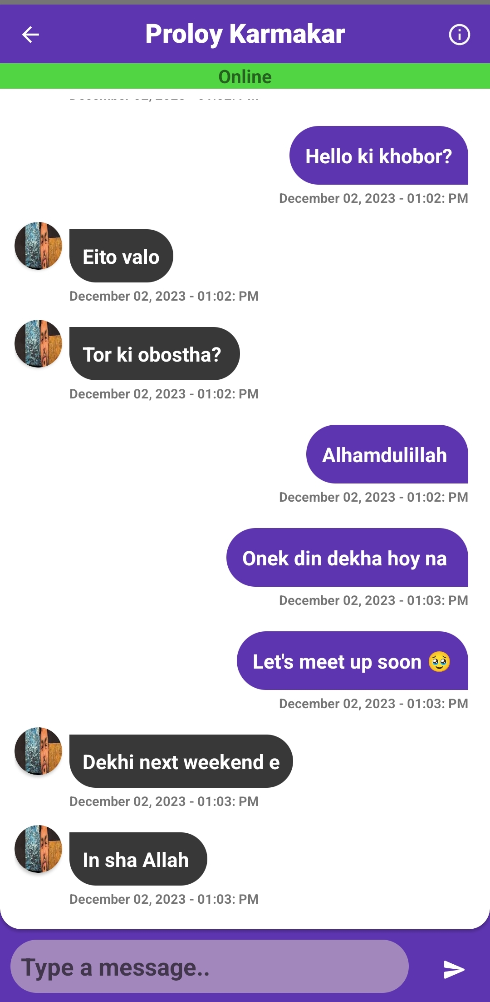
Implementation (cont.)
Fig 8 : Chat Page

Slide 11
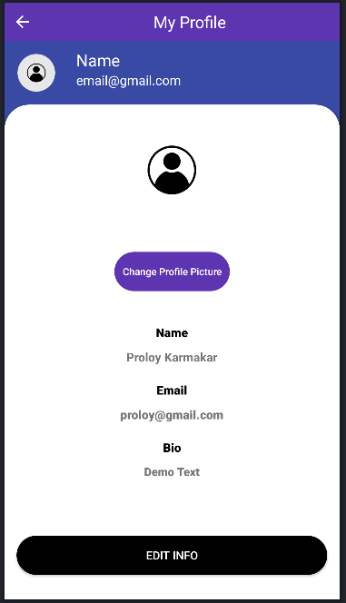
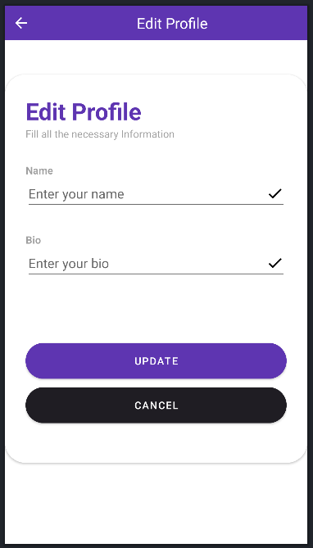
Implementation (cont.)
Fig 9 : My Profile Page
Fig 10: Edit Profile Page

Slide 12
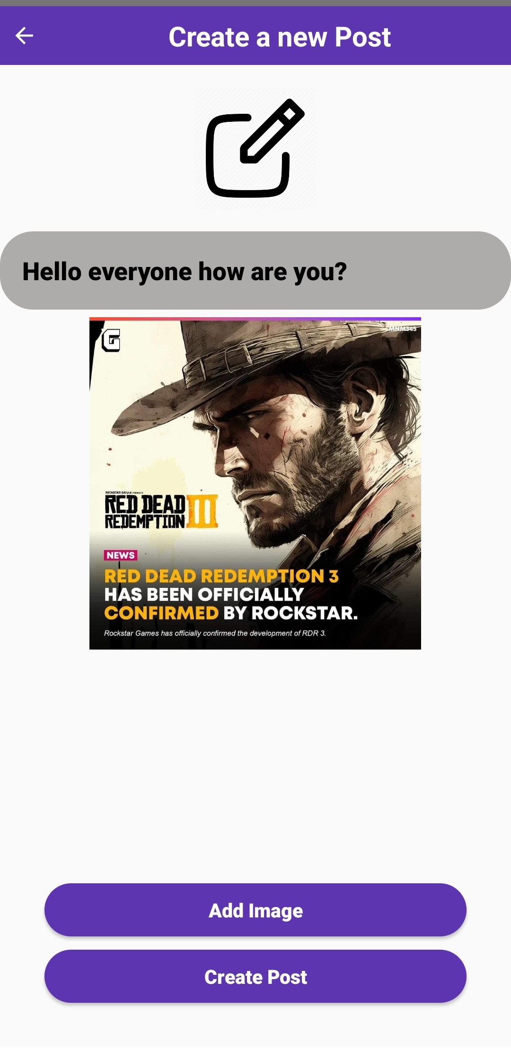
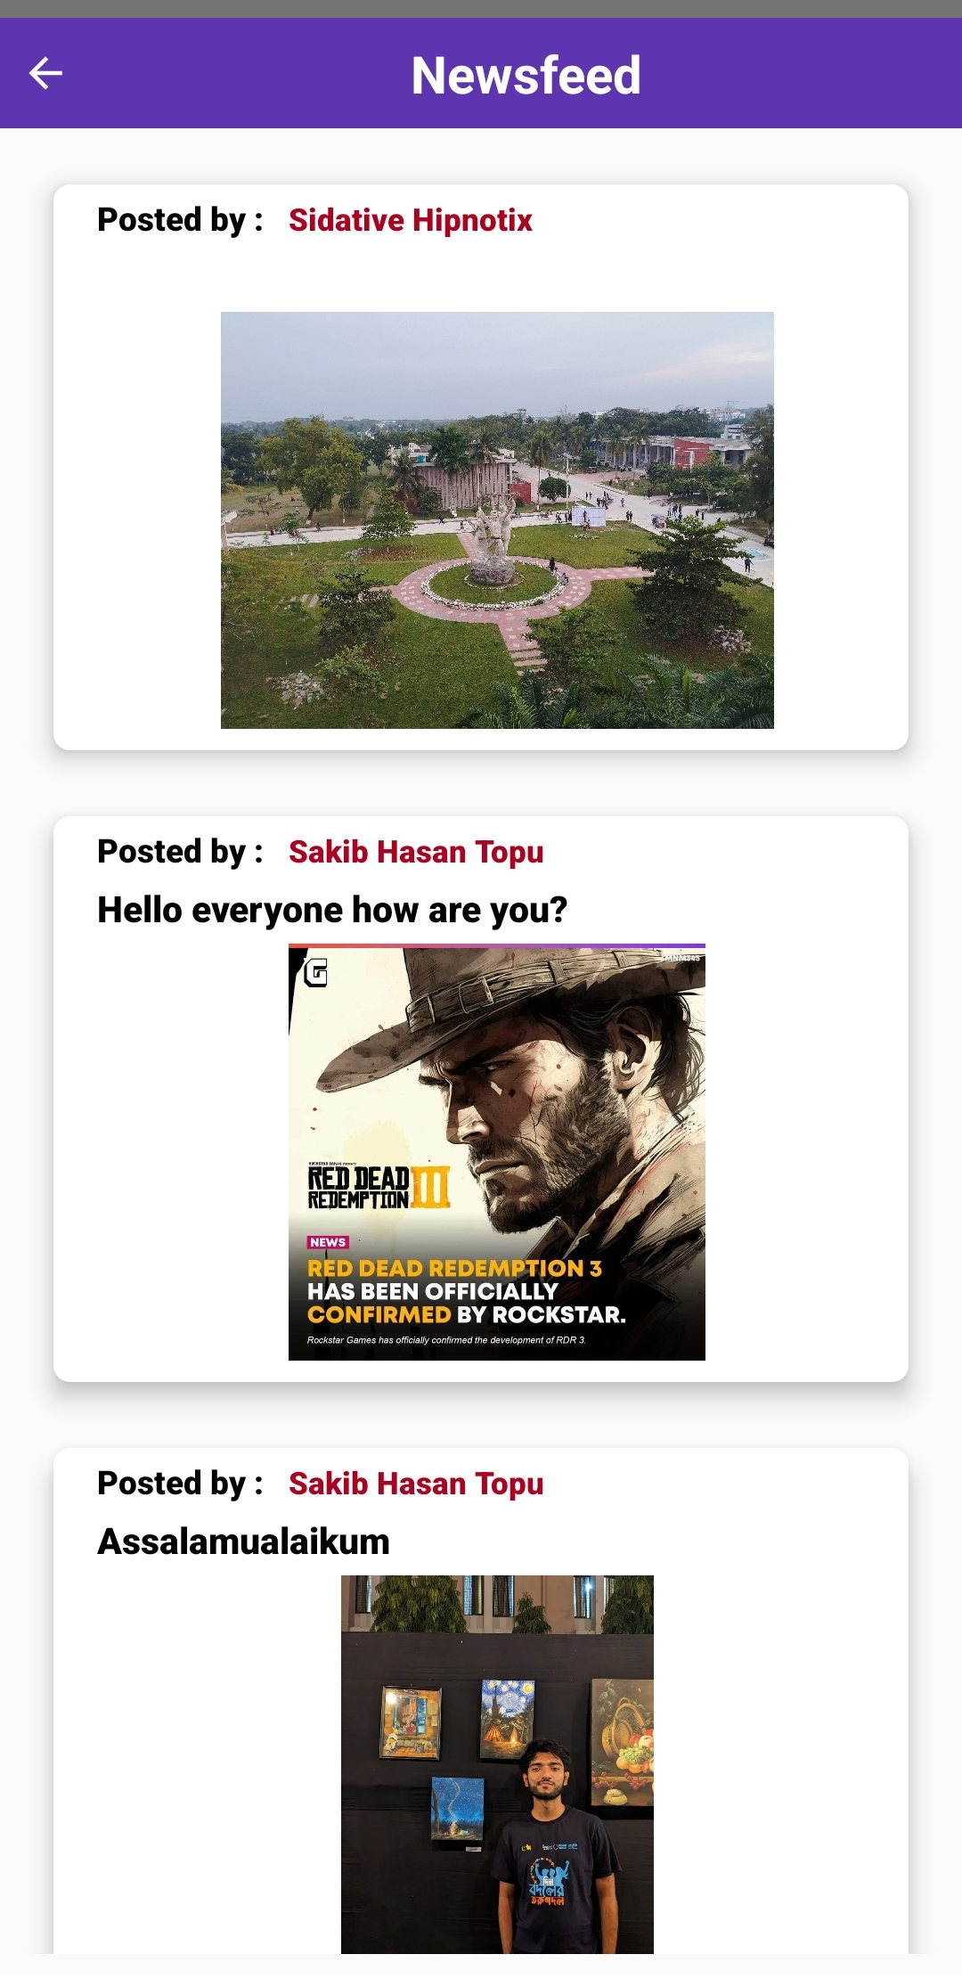
Implementation (cont.)
Fig 11 : Add Post
Fig 12 : News-Feed

Slide 13
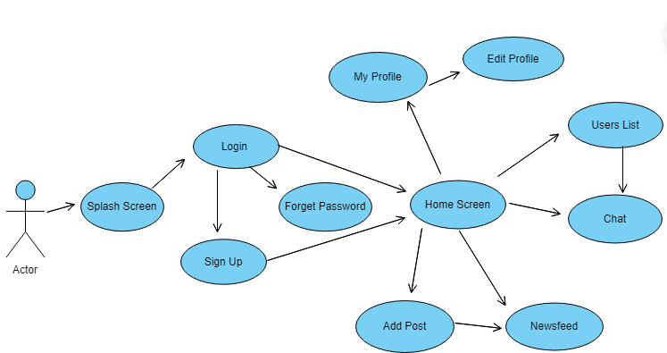
Implementation (cont.)
Use Case Diagram
Fig 13: Use case Diagram

Slide 14
Tools/Platforms Used
Android Studio
Firebase
Firestore
RealTime Database
Cloud Messaging
Authentication
Retrofit

Slide 15
Future Scope
End to End Encryption
Blocking a user
Unsending a message
Audio and Video Calling Integration

Slide 16
Conclusion
In conclusion, the development of our system project “Aalap” has been a fulfilling journey marked by innovation, collaboration and a commitment to deliver a user centric communication platform. As the project concludes, it leaves a great impact on both the development team and users’ community.
But while developing the project, we faced some challenges like:
Resource Limitations
User Feedback Integrations
Technical Challenges
Remote Collaborations

Slide 17
References
https://firebase.google.com/docs/firestore/manage-data/add-data
https://square.github.io/retrofit/
https://firebase.google.com/docs/cloud-messaging

Slide 18
Thank You

